Slide 1
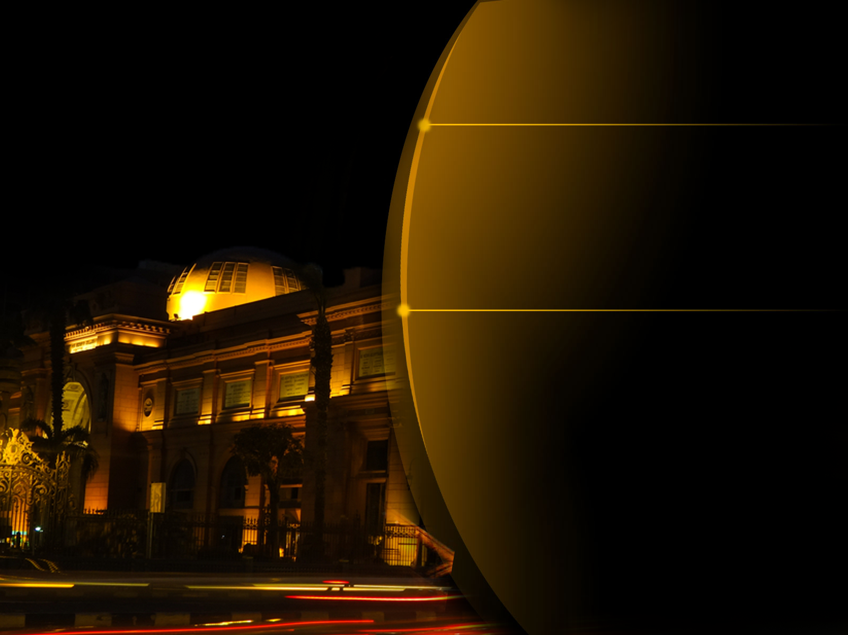

Graduation Project
Mobile App To Help Tourists
In Egyptian Museum
Under Supervision
Dr. Amr Mohamed Abd-ellatif
By Assistance Of
Eng. Mahmoud Mahdi

Slide 2


Team Member
Mohamed Abd-Elhakeem
Mahmoud Ahmed Mahmoud Helmy
Mohamed Adel El-Tabakh
Yara Mohamed
Toqa Hesham
Mahmoud Fawzy El-Ansary

Slide 3

Content
1
Motivation
2
Planning
Why tourism field .
Statistic about Egyptian museums .
Why Egyptian museum .
Problem Statement .
Solution .
Scope And Contribution .
3
Analysis
4
Design
Requirements
Statue Data Collection .
Functional Requirements .
Non Functional Requirements.
User Interface Design .
Database Design .
5
Implementation
Element Of App .
Future Work .

Slide 4
1
Motivation
Why tourism field
Egypt From The Biggest Country in Tourism Field .
The Tourism Is The Most Important Source For Nation Income .
Culture Tourism Is The Most Important Type Of Tourism In Egypt Because it’s Museum That Contain on a lot of Monuments .

Slide 5
1
Motivation
Statistic about Egyptian museums
Egypt Has 72 museums In 19 Governments .
The Number Of Visitors To These Museum In 2016 Is 9 Millions Visitor
The Number Of Visitors To Museums That Located In Cairo Which are 24 Museums is 5 Millions Visitors

Slide 6
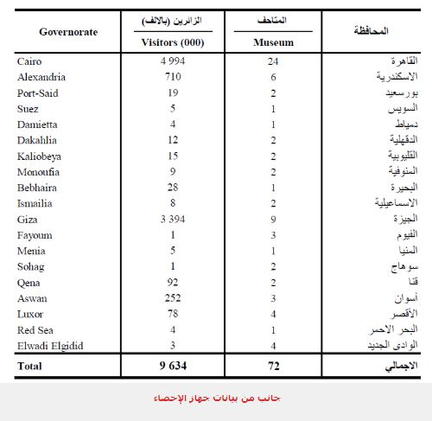
Statistic about Egyptian museums

Slide 7
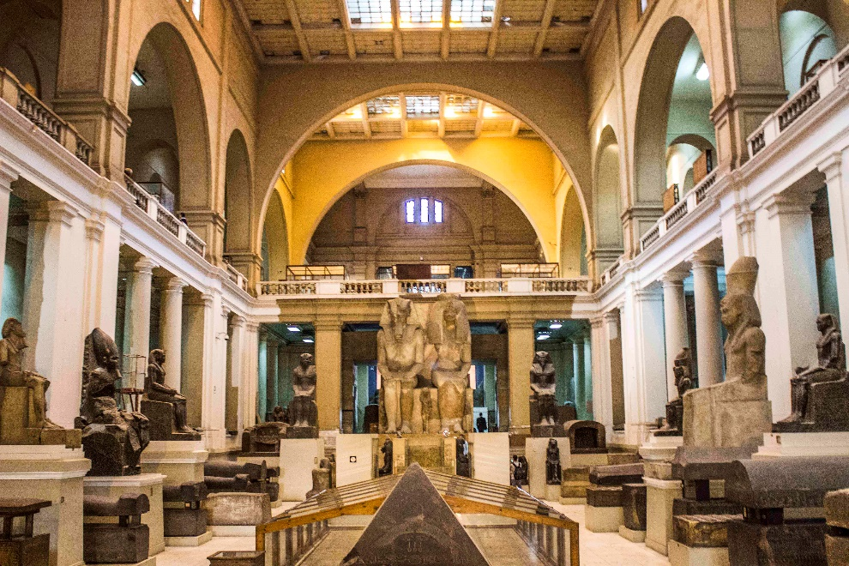
Why Egyptian museum
It has one of the best collections of antiquities and artifacts
The museum collection exceeds 120 000 objects which range from
the historic era to the Greco-Roman period .
A hall for the royal mummies is also found in the museum which
houses eleven kings and queens.
More than 1.5 million tourists visit the museum per year
and this is in addition to the 500 000 Egyptians who visit it per year
Notes:
مجموعات المتحف
عصور ما قبل التاريخ
عصر التأسيس
عصر الدولة القديمة
عصر الدولة الوسطى
عصر الدولة الحديثة
العصور المتأخرة

Slide 8
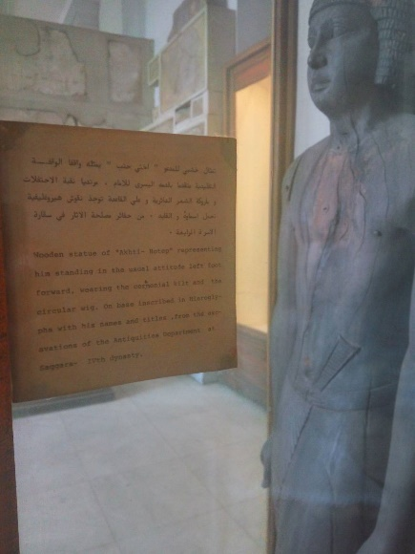
2
Planning
Problem Statement
When you visit museum
do not know things history or what it was for and that's a problem.
So to solve that problem you should hire a tour guide which is
a traditional way and costs a bunch of dollars.
The label on Statues doesn’t Have enough information

Slide 9
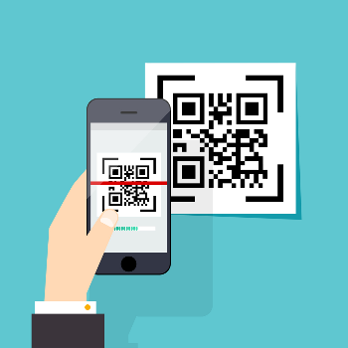
2
Planning
Solution
We aim to solve this problem with our project .
we will attach a QR code for each object .
you need to do for getting info about any piece is to scan that
QRcode with your android phone .
once you scan the QR code it will retrieve a recording including
info about this piece.
You can also make a group and add whoever you want to listen
together to this recording.

Slide 10
2
Planning
Scope And Contribution
Our project doesn’t aim to get rid of tour guide at all.
We want to help making a visit to the museum the best way
it could be .
Beginning with most famous objects which most liked by visitors
We provide two languages at this very time Arabic and English.
There will be the ability to listen in groups
We believe that with this very project we urge everyone
to go pay a visit to the Egyptian museum
you don’t need to worry about how you could find a good tour guide

Slide 11
3
Analysis
Requirements
Database
Web Service
Xampp
QT
FCM
Firebase Cloud Messaging
Mobile App

Slide 12
3
Analysis
Database
Using mySql Database to Organize Info in tables.
Web Service
It make mobile App easy talk to server using PHP programming language.
Mobile App
We use Android with java programming language and XML.
QT
is a cross platform application development framework we Generating QR code with QT

Slide 13
3
Analysis
FCM Firebase Cloud Messaging
It is a cross-platform messaging solution that lets you reliably deliver
messages at no cost
Using FCM, you can send notification messages to drive user re-engagement and retention.(Share listening)
Xampp
is a free and open source cross-platform web server to create a local web server for testing and deployment purposes.

Slide 14
3
Analysis
Statue data collection
Our visit to Egyptian museum.
start to collect names of some statues , some photos for
them as a "beginning" for the application.
A) for data in Arabic language:
1-Mesrona blog
2-book titled «المتحف المصري «

Slide 15
3
Analysis
Statue data collection
B) for data in English language
1- book titled “Ancient Egypt at the Cairo Museum”"
2-book titled “The Complete Royal Families of Ancient Egypt” "
**We collect statues data as text file , from websites like :
http://www.fromtexttospeech.com/
We converted text to audio files used by project media player
**some pictures for statues from http://pinterest.com/

Slide 16
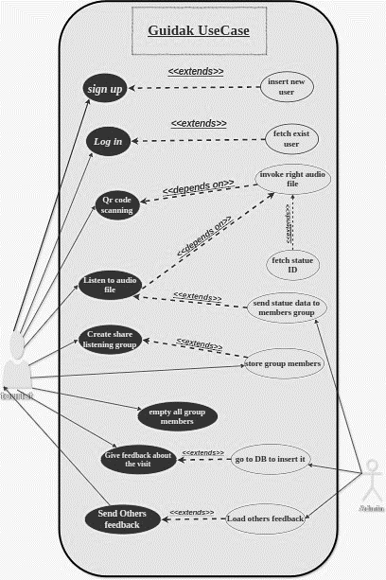
3
Analysis
Use Case Diagram

Slide 17
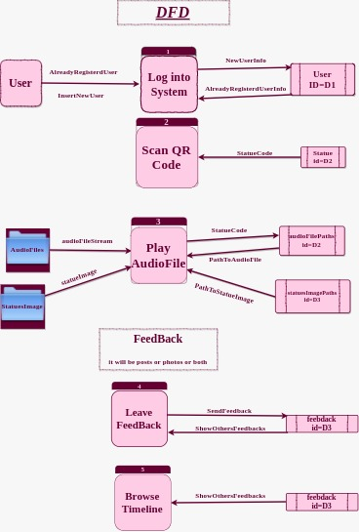
3
Analysis
Data Flow Diagram

Slide 18
3
Analysis
Functional Requirements
1-LOGIN:
The system will allow the user to login the system.
2-SCAN QR CODE:
The system will allow the user to scan qr code for the statue to retrieve the required audio file.
3-FEEDBACK:
The system will allow the user to write his feedback about the Place.
4-ALL FEEDBACK:
The system will allow the user to show all feedback about users.
5-LOGOUT :
The system will allow the user to logout from the system.

Slide 19
3
Analysis
Non Functional Requirements
1-Operational
The user database will be constructed to add users who registered to App, store feedback ,store data about statues.
The system will be run on the mobile
2-Performance
Feedback display must be speed
Interface should be simple
3-Security
passwords of users must be encrypted well.

Slide 20
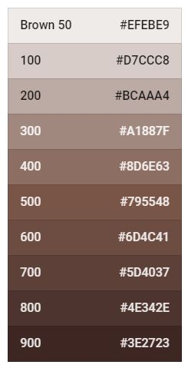
4
Design
User Interface Design
In Interface We Use color that indicate
the statues, Stone And Egyptian Museum Building
We get color code from Material Design on google
website .

Slide 21
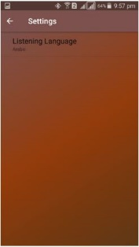
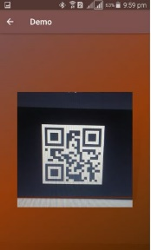
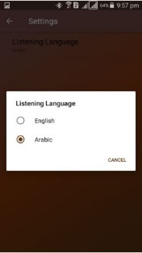
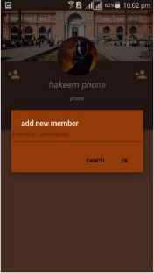
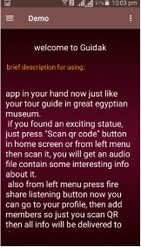
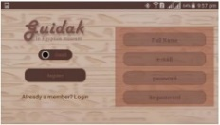
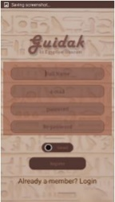
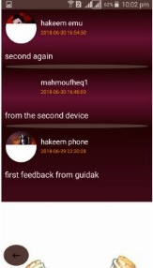
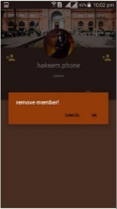
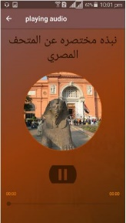
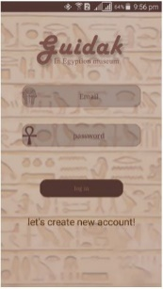
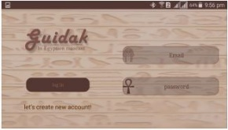
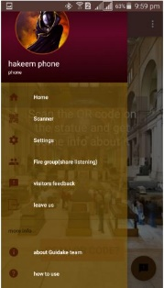
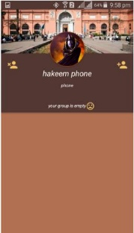
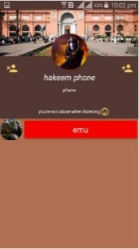
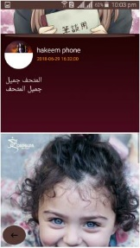
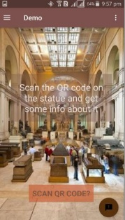
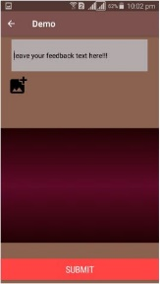
Guidak
Log in
Sign up
Home Screen
Setting
profile
Make Group
Scan QR
Listen to AudioFile
Leave FeedBack
Browse Others FeedBack
How To Use App
4
Design

Slide 22
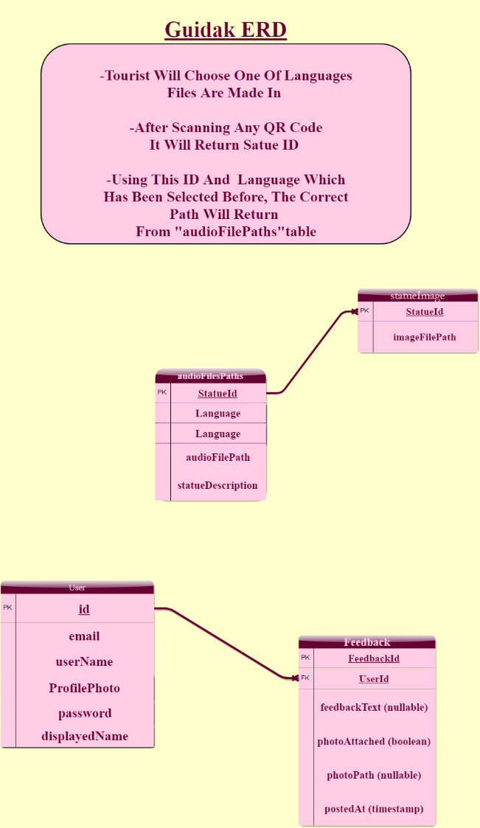
4
Design
Database Design –
ER Diagram

Slide 23
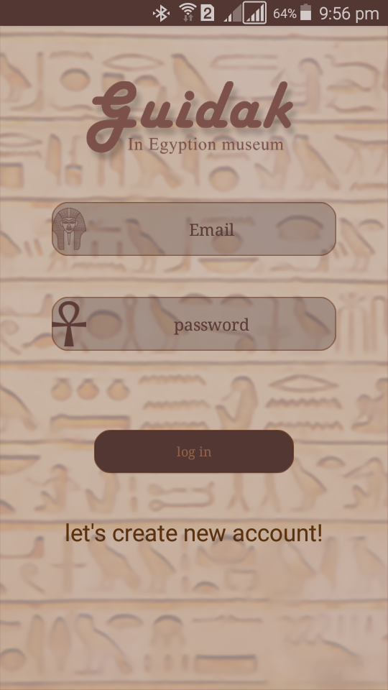
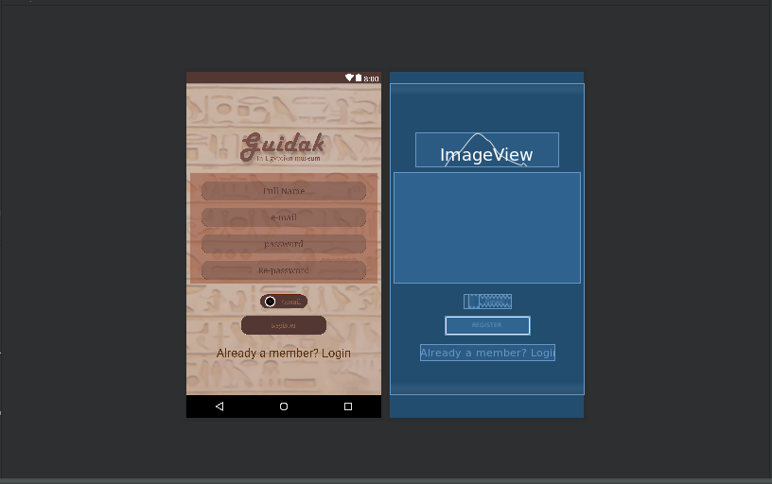
5
Implementation
Element Of App
1- Log in : enter both the email and password and press
the button log in to start our in-app
2- Register : This in the case that user use the App for the first time

Slide 24
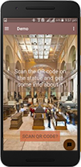
5
Implementation
3- Home : :This is the first page seen by the user after the process of login or registration.
it is interacting with all the processes that occur within the application.
components of home activity:
1- SCAN QR CODE button
2- menu
3- List

Slide 25
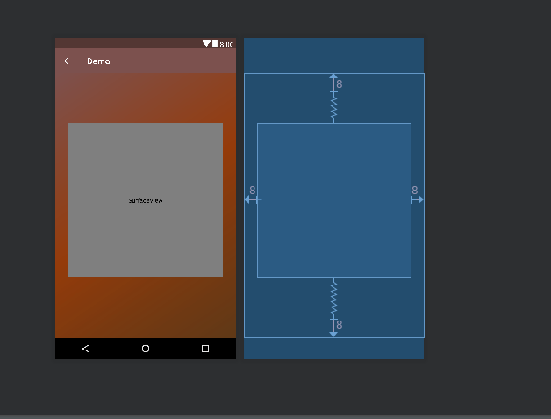
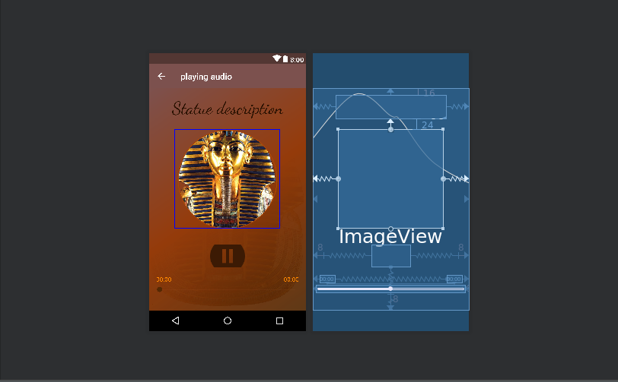
5
Implementation
4- SCAN QR CODE Layout :
scan with your camera to the statue then you will get the audio and you will see the audio player and the photo of the statue

Slide 26
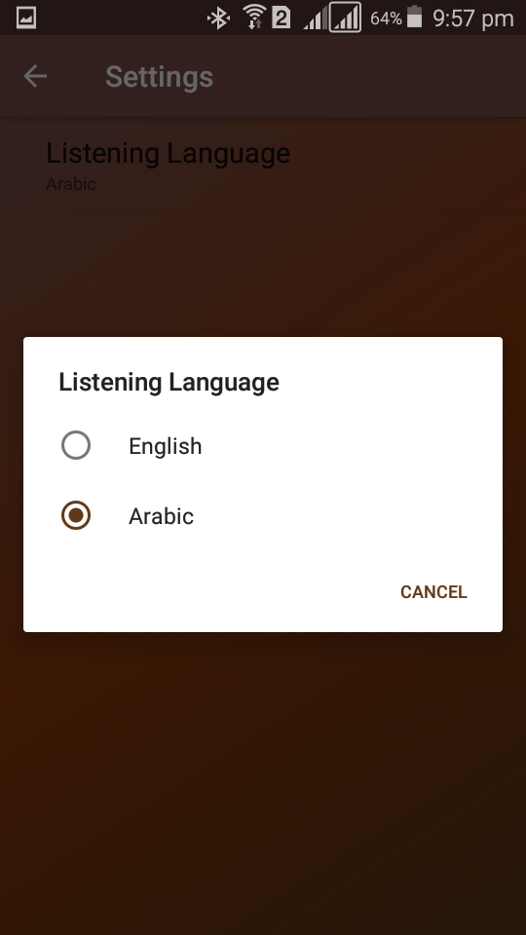
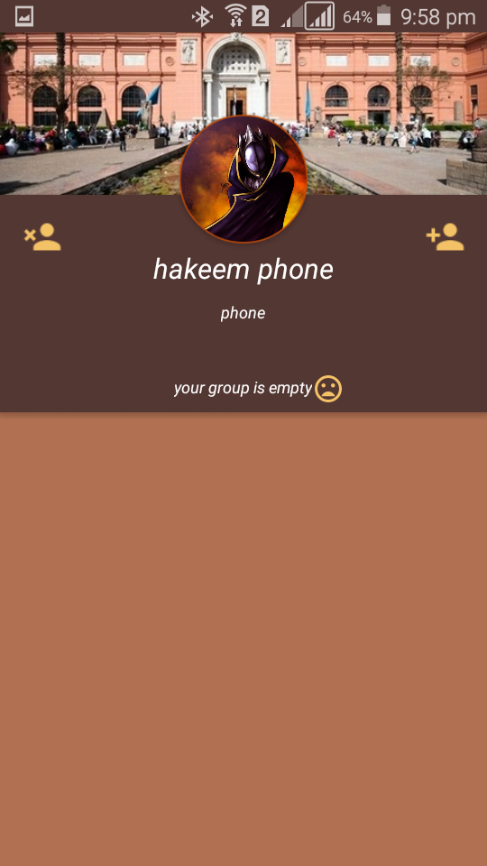
5
Implementation
5- Settings : From settings you can choose your
listening languages.
:
6- Fire group (share listening): If
you in a group and you are the admin of it
you can share the listening audio.
:

Slide 27
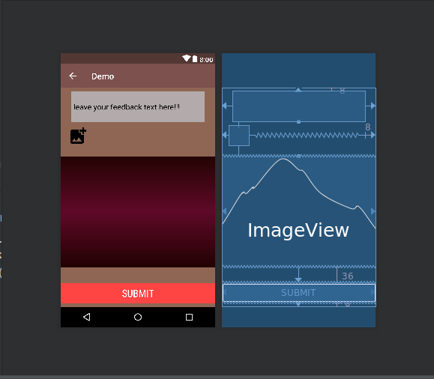
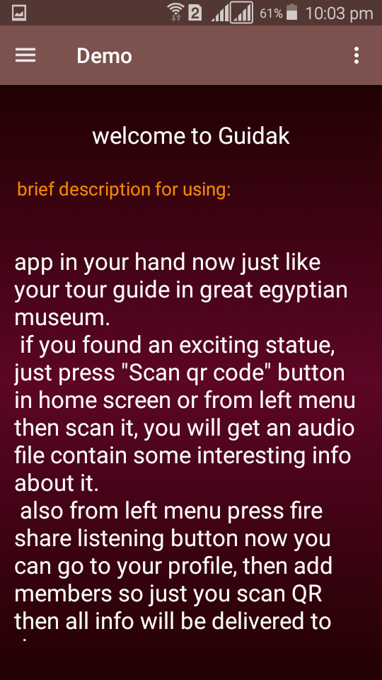
5
Implementation
7- Visitors feedback : You can write your feedback
about the place and service
8- How to use : from this page you can
know how to use the Application

Slide 28
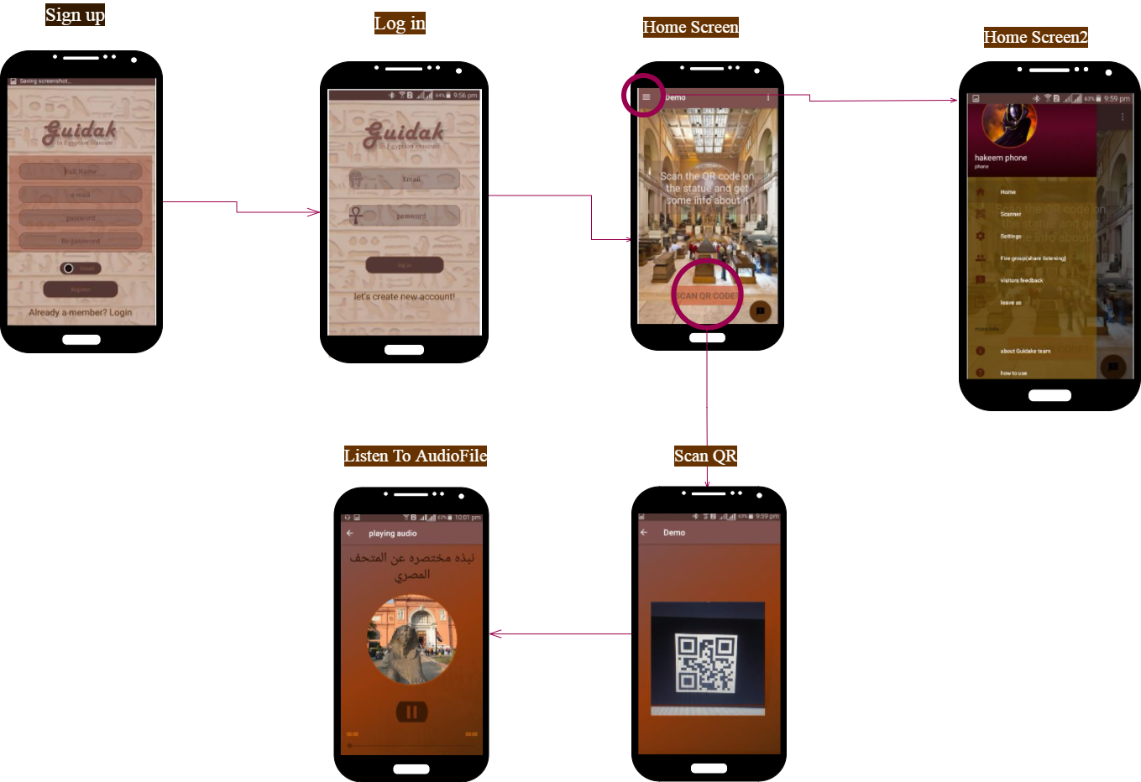
App Flow Chart

Slide 29
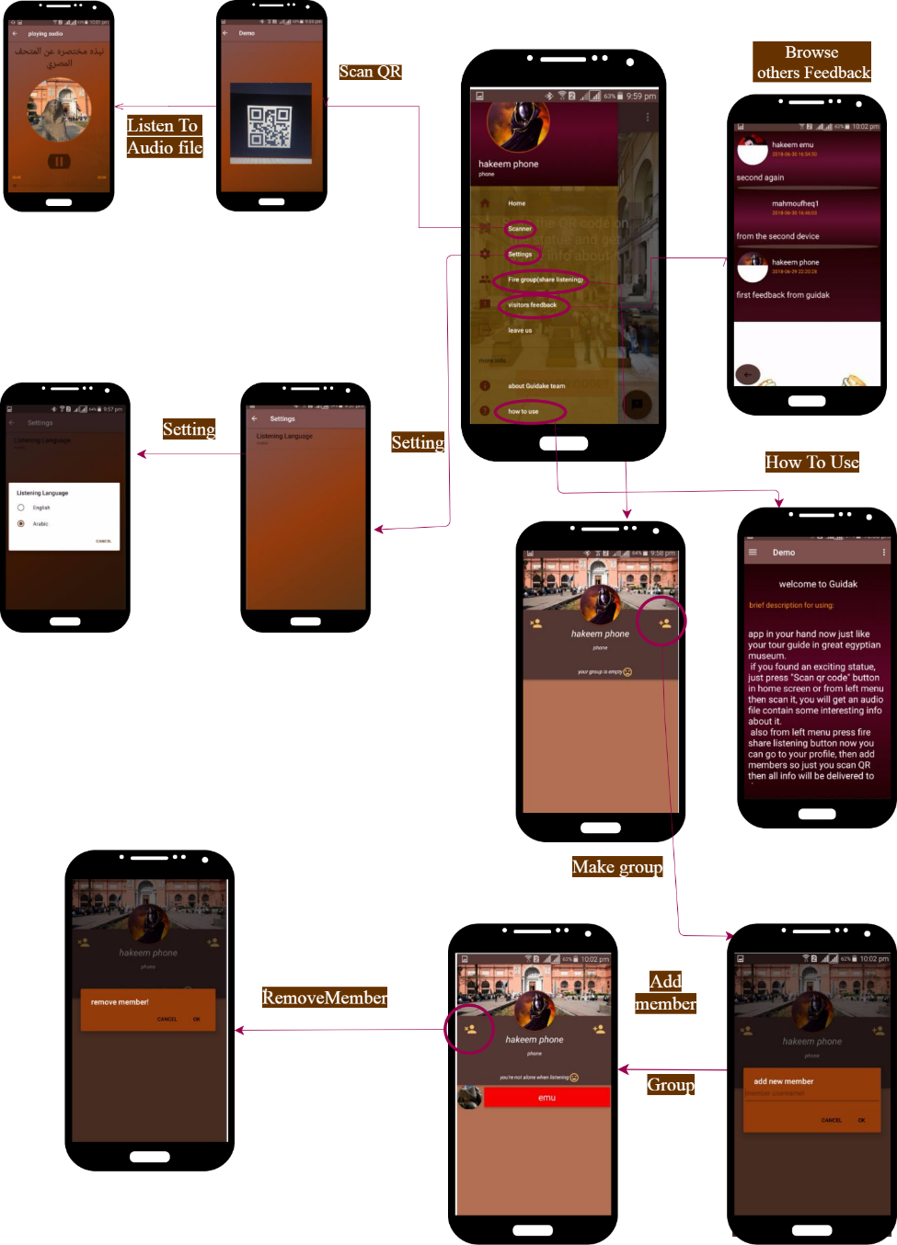
App Flow Chart

Slide 30
5
Implementation
Future Work
Our future plane for this project will include enhance some
features and add other
features will be enhanced:
share listening mechanism will be enhanced.
browsing other visitors feedback.
B) feature will be added:
track user while his visit to Egypt to notify him by nearby
historical places .
add more museums to data base to spread its use outside
Egyptian museum only

